Slide 1
OOP
Exercises

Slide 2
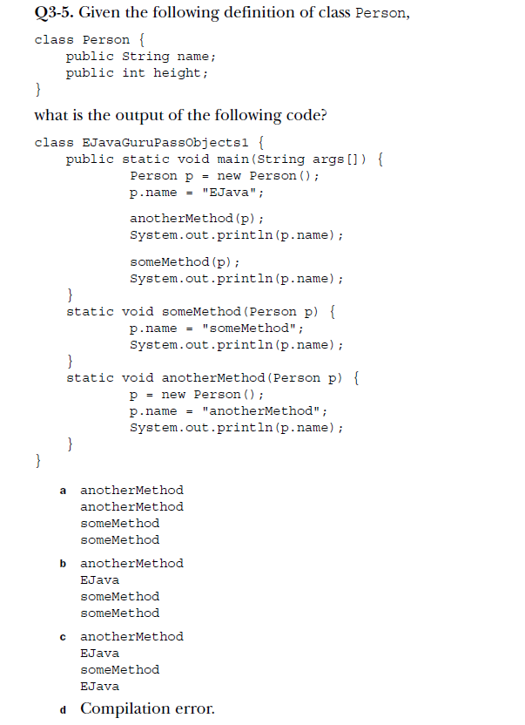
Notes:
b

Slide 3


Slide 4
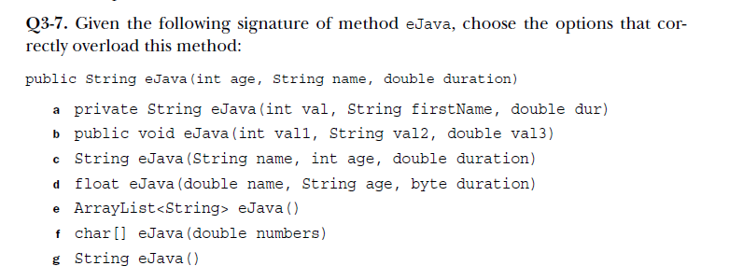
Notes:
c,d,e,f,g

Slide 5
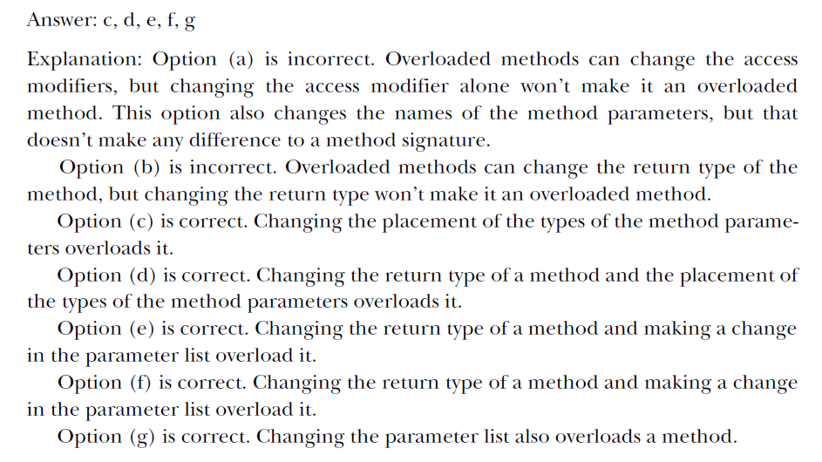

Slide 6
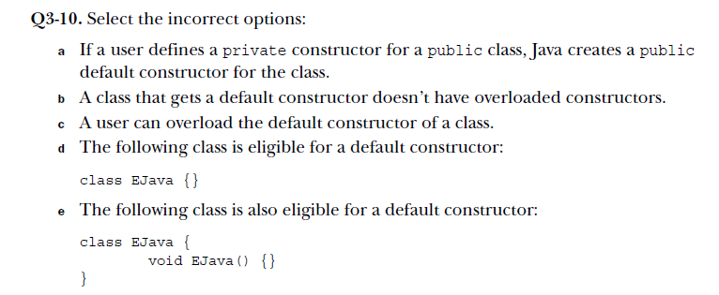
Notes:
a,c

Slide 7
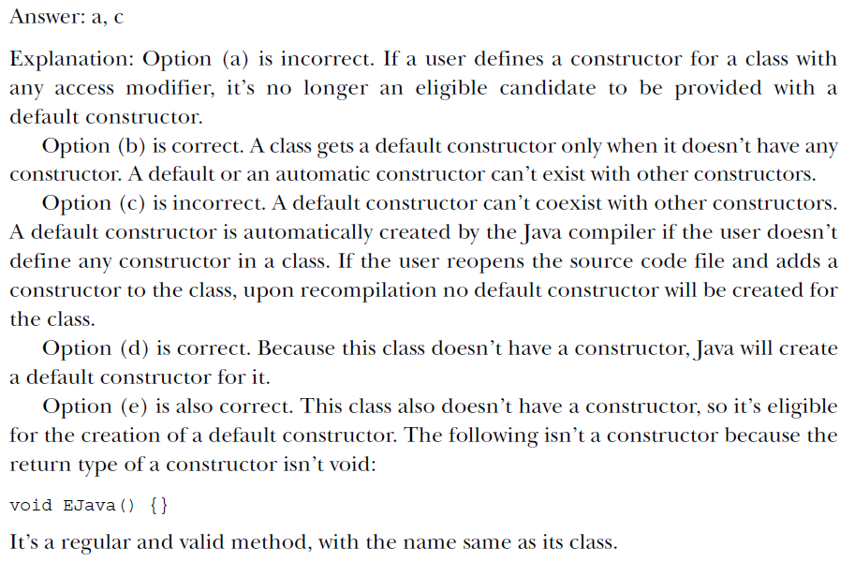

Slide 8
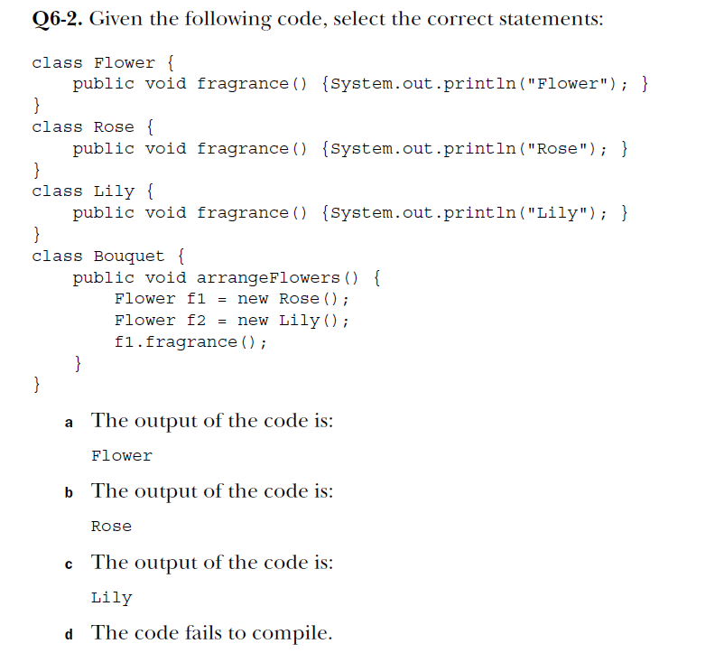

Slide 9


Slide 10
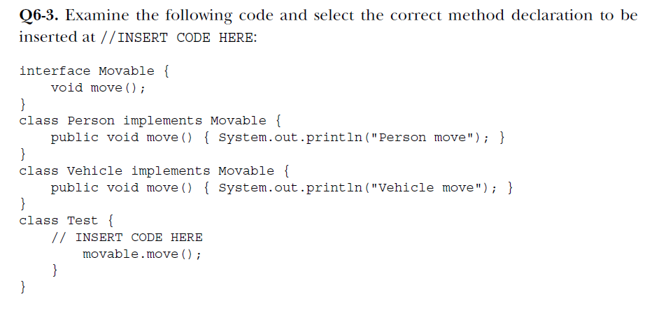


Slide 11
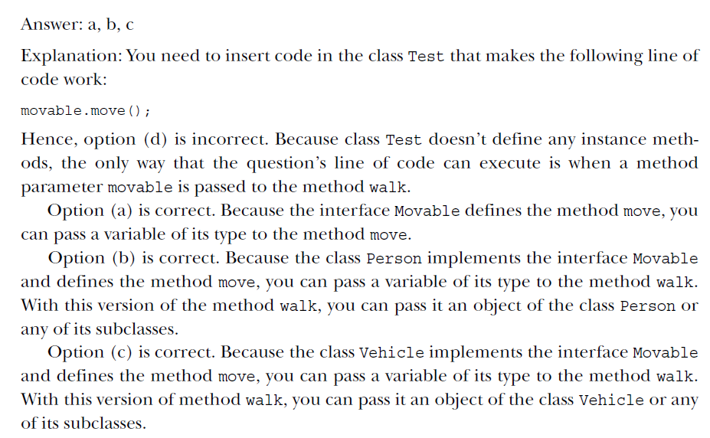

Slide 12


Slide 13
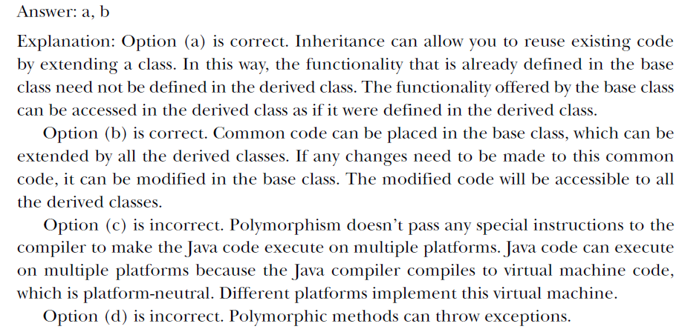

Slide 14


Thank you! ☺
Elena Pistol
Developer
elena.pistol@endava.com
en_epistol

